Slide 1
Index Notation Lesson 1
Year 8 Mathematics
Mrs Parlevliet

Slide 2
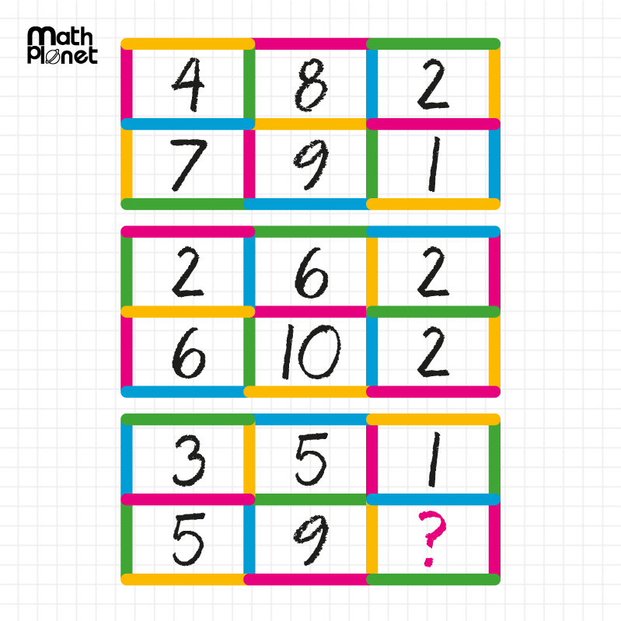
24
7
30
Index Notation
Date
EQ – What is index notation?
Notes:
Starter activity to be completed on the left hand side.
If students are stuck on where to begin, provide them with the hint that the Order of Operations can help them find a link.

Slide 3
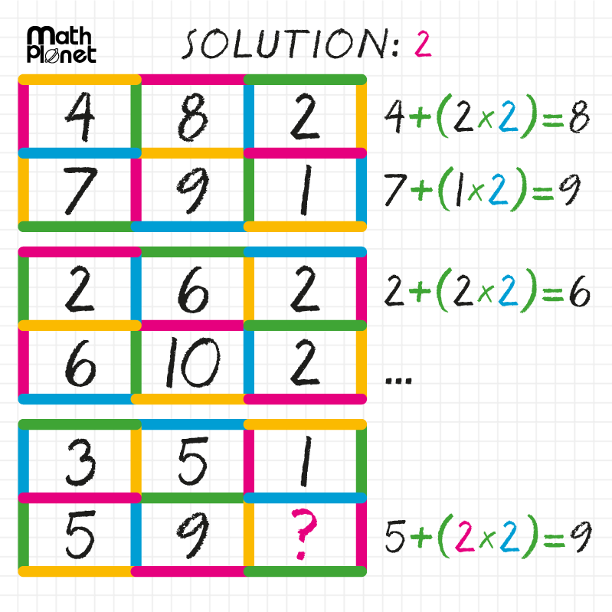
24
7
30
Index Notation
Date
EQ – What is index notation?

Slide 4
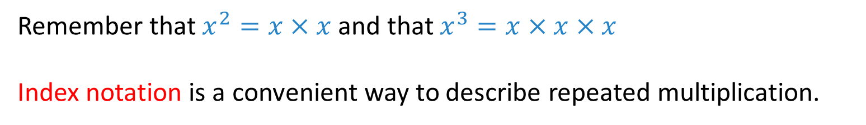

24
7
30
Index Notation
Date
EQ – What is index notation?
Remember that $x^{2}=x×x$ and that $x^{3}=x×x×x$
Index notation is a convenient way to describe repeated multiplication.
Exponent or index
$$2^{5}$$
Base

Slide 5
24
7
30
Index Notation
Date
EQ – What is index notation?
How do I read index notation?
3 = 3¹ | (read as '3' or '3 to the power 1')
3 × 3 = 3² | (read as “3 squared”)
3 × 3 × 3 = 3³ | (read as “3 cubed”)
3 × 3 × 3 × 3 = 3⁴ | (read as “3 to the power 4” or as “3 to the 4th")
3 × 3 × 3 × 3 × 3 = 3⁵ | (read as “3 to the power 5” or as “3 to the 5")
3 × 3 × 3 × 3 × 3 × 3 = 3⁶ | (read as “3 to the power 6” or as “3 to the 6”)

Slide 6
24
7
30
Index Notation
Date
EQ – What is index notation?
How do I solve problems with index notation?
Example 1: Calculate 6²
6² means 6 x 6
=
36
Example 2: Evaluate 2⁵
2⁵ means 2 x 2 x 2 x 2 x 2
=
32
Example 3: Find 9⁴
9⁴ means 9 x 9 x 9 x 9
=
6561
Notes:
Point out calculate, evaluate as language = give me a number!

Slide 7
24
7
30
Index Notation
Date
EQ – What is index notation?
How do I solve problems with index notation?
Example 4: Write a² in factor form
a² means a x a
Example 5: Write b⁵ in factor form
b⁵ means b x b x b x b x b
Example 6: Write f⁴g³ in factor form
f⁴g³ means f x f x f x f x g x g x g
Notes:
Point out calculate, evaluate as language = give me a number!

Slide 8
24
7
30
Index Notation
Date
EQ – What is index notation?
How do I solve problems with index notation?
Example 7: Write k x k in index form
k x k means k²
Example 8: Write m x m x n x n x n in index form
m x m x n x n x n means m²n³
Example 9: Write 3gg3ggg3 in index form
3gg3ggg3 means 3³g⁵
Notes:
Point out calculate, evaluate as language = give me a number!

Slide 9
Task
Use your notes to complete Exercises 1.2, 1.3 and 1.4 in the Dwyer Year 8 Textbook, page 3

